Slide 1
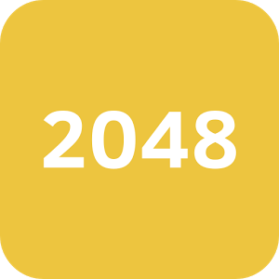
2048 (Puzzle game)
2048 is a single-player puzzle game created in March 2014 by 19-year-old Italian web developer Gabriele Cirulli, in which the objective is to slide numbered tiles on a grid to combine them and create a tile with the number 2048.

Slide 2
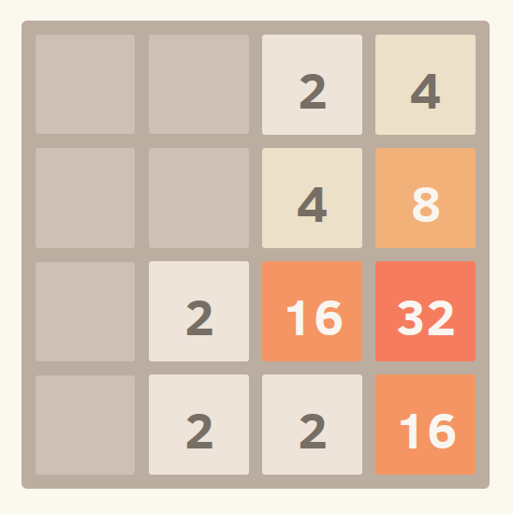
Gameplay
2048 is played on a simple gray 4×4 grid, with numbered tiles that slide smoothly when a player moves them using the four arrow keys.
Every turn, a new tile will randomly appear in an empty spot on the board with a value of either 2 or 4.
Tiles slide as far as possible in the chosen direction until they are stopped by either another tile or the edge of the grid. If two tiles of the same number collide while moving, they will merge into a tile with the total value of the two tiles that collided.
The resulting tile cannot merge with another tile again in the same move. Higher-scoring tiles emit a soft glow.

Slide 3
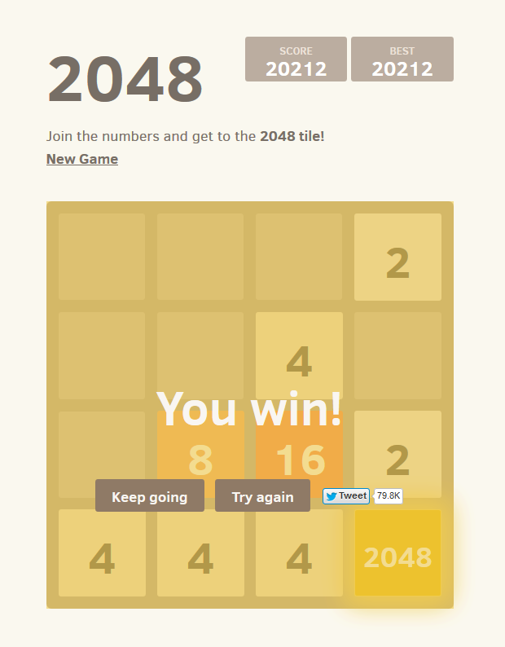
Gameplay cont…
A scoreboard on the upper-right keeps track of the user's score. The user's score starts at zero, and is incremented whenever two tiles combine, by the value of the new tile.
The game is won when a tile with a value of 2048 appears on the board, hence the name of the game. After reaching the target score, players can continue in a sandbox mode that continues beyond 2048.
The maximum possible tile is 131,072 (or 2¹⁷); the maximum possible score is 3,932,156; the maximum number of moves is 131,038.
When the player has no legal moves (there are no empty spaces and no adjacent tiles with the same value), the game ends.

